Slide 1






Coral Classification and Detection: Advancing Underwater Imaging for Biodiversity Monitoring Paper ID: 297
Prakhar Gupta, Ayushman Baghel, Dr. Shitala Prasad, Pankaj P Singh . IIT Goa

Slide 2
Introduction
Coral reefs cover less than 1% of the ocean but provide habitat for over 25% of marine species ^{[1]}.
Oceans act as a net absorber of CO₂, helping regulate global climate ^{[2]}.
Coral reefs play a crucial role in coastal protection, preventing erosion and storm damage ^{[3]}.
Due to global warming and ocean acidification, coral ecosystems face severe stress ^{[4]}.
Coral bleaching is increasing due to rising sea temperatures, leading to loss of biodiversity ^{[5]}.
Monitoring and analysis are essential to track coral health and detect early signs of damage ^{[5]}.
Current coral analysis relies on expert divers, which is expensive, slow, and resource-intensive ^{[5]}.
AI-driven solutions can help automate classification, detection, and health monitoring of corals.
Developing a robust dataset is essential for training AI models for accurate identification.
Our research focuses on enhancing dataset quality and leveraging deep learning models for coral classification and detection.

Slide 3
Challenges
Underwater images suffer from distortions, including:
Motion blur
Light absorption
Color shifting
Coral species look visually similar, making classification difficult.
Some species require electron microscopy for 100% accuracy.
Need for high-quality, close-range images for accurate classification.
Environmental factors like water turbulence affect image quality.
Limited availability of annotated datasets for training deep learning models.
Coral species exhibit variations in growth forms, adding to classification complexity.
Real-time detection requires high computational efficiency to process images quickly.
Imbalanced datasets cause bias in model predictions.
Need for advanced augmentation techniques to improve training data.
Ensuring model adaptability to different underwater conditions is challenging.
Addressing false positives and false negatives in classification is crucial.
Coral Species although can be visual identified, many coral species need electron microscope for 100% accurate identification.

Slide 4
Dataset
We developed three datasets, each designed for a specific task.
Data augmentation techniques used:
Rotation
Horizontal flipping
Brightness adjustment
Dataset cleaning and annotation process:
Manual labeling
Removal of duplicate/misclassified images
Goal: Develop a standard coral dataset for researchers.
Challenges in dataset creation:
Underwater image distortion
Class imbalance
Lack of labeled data
Dataset is designed for scalability to include more species.
Future work: Collaborate with marine biologists for expert annotations.
Binary Classification | Multiclass Classification | Coral Detection
Coral: 32,187 images | 27 coral species | Training set: 49,533 images Validation set: 4,372 images
Non Coral: 27,887 images | 1 Marine Class, 1 Other class | Test set: 3,081 images
Total: 60,074 images | Total: 29 classes | Total: 56,986 images

Slide 5
Models Overview
We tested CNNs and Vision Transformers (ViTs) for classification.
CNN architectures used:
ResNet-50
EfficientNet-B4 & B7^{[10]}
ViT architectures used:
Google ViT-Base^{[9]}
CoCa ViT^{[8]}
Object detection model used: YOLOv8
CNNs excel in feature extraction from underwater images.
ViTs are more efficient in learning long-range dependencies.
EfficientNet models perform well with fewer parameters.
YOLOv8 is used for object detection due to its speed and accuracy.
Vision Transformers require large datasets for optimal training.
Our study compares model performance across tasks (binary, multiclass, detection).

Slide 6
Binary Classification Results
Task: Determine whether an image contains coral or not.
Best Performing Model: EfficientNet-B7 (97.83% accuracy)
Performance of Other Models:
ResNet-50: 96.79%
EfficientNet-B4: 97.75%
Google ViT-Base: 96.96%
CoCa ViT: 97.17%
Key Observations:
Vision Transformers (ViTs) performed competitively but required longer training times.
EfficientNet-B7 outperformed CNNs and ViTs while being more computationally efficient.
CoCa ViT had high accuracy but marginal improvement over EfficientNet.
The use of data augmentation (flipping, rotation, brightness adjustment) improved performance.
Conclusion:
EfficientNet-B7 is the best model for binary classification due to its high accuracy and efficiency.

Slide 7
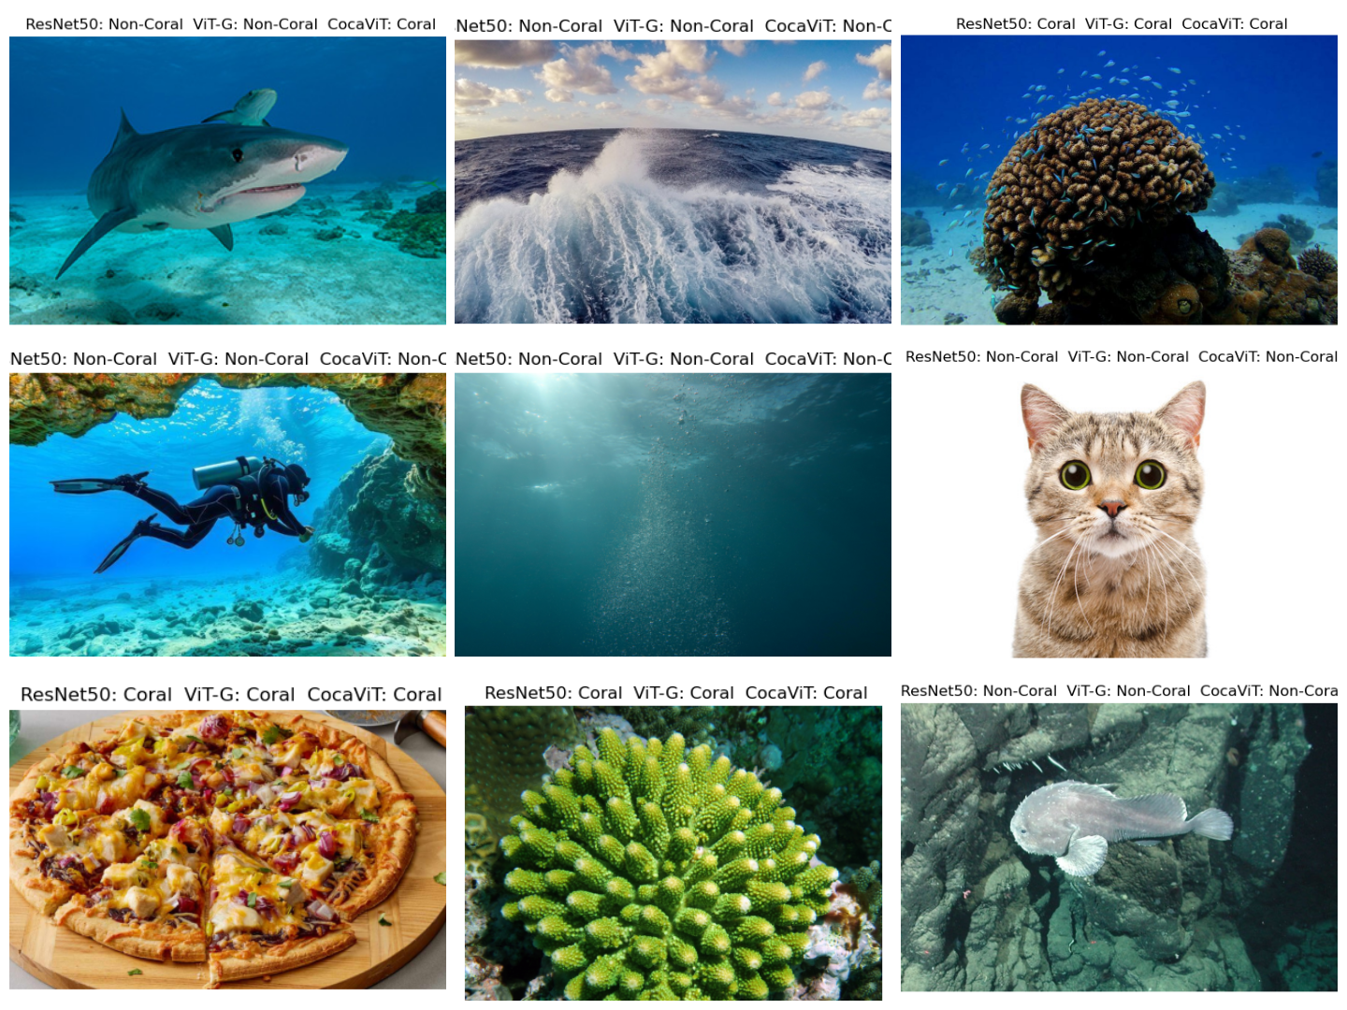
Binary Classification Visual Results

Slide 8
Multiclass Classification Results
Task: Classify images into 29 categories (27 coral species, 1 Marine class, 1 Other class).
Best Performing Model: Google ViT-Base (95.95% accuracy)
Performance of Other Models:
ResNet-50: 91.15%
EfficientNet-B4: 94.13%
EfficientNet-B7: 94.64%
CoCa ViT: 95.40%
Key Observations:
Google ViT-Base outperformed other models, leveraging transformers’ ability to learn long-range dependencies.
CoCa ViT performed similarly to ViT-Base, but the performance gain was not significant given its size.
EfficientNet-B4 and B7 were highly competitive and more efficient than ViTs.
Conclusion:
Google ViT-Base is best for multiclass classification due to its high accuracy and generalization ability.

Slide 9
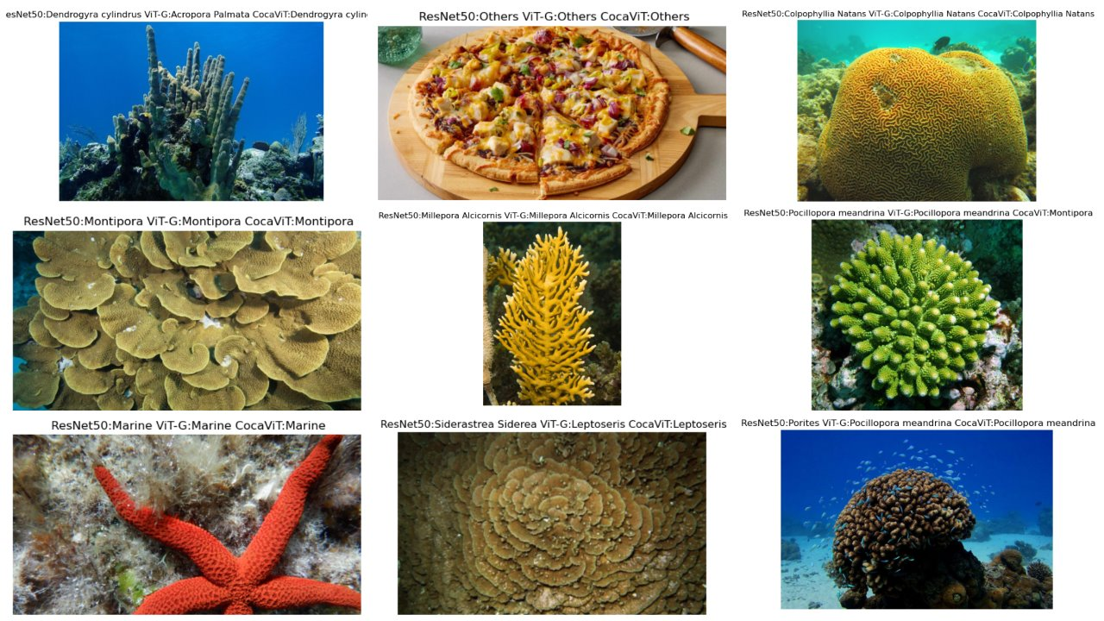
Multiclass Classification Visual Result

Slide 10
Object Detection Results
Task: Detect and locate corals in underwater images.
Best Performing Model: YOLOv8x
Performance Metrics:
YOLOv8n (Nano)
mAP@0.5:0.95 = 44.05%
Best for high FPS, low accuracy
YOLOv8l (Large)
mAP@0.5:0.95 = 49.59%
Balanced performance
YOLOv8x (Extra Large)
mAP@0.5:0.95 = 68.2%
Highest accuracy, slowest inference
Key Observations:
YOLOv8x detected corals with the highest precision.
YOLOv8l provided the best balance between speed and accuracy, making it a strong candidate for real-time applications.
YOLOv8n was computationally efficient but had the lowest accuracy.
Conclusion:
YOLOv8x is the best model for object detection, but YOLOv8l is preferable for real-time applications.

Slide 11
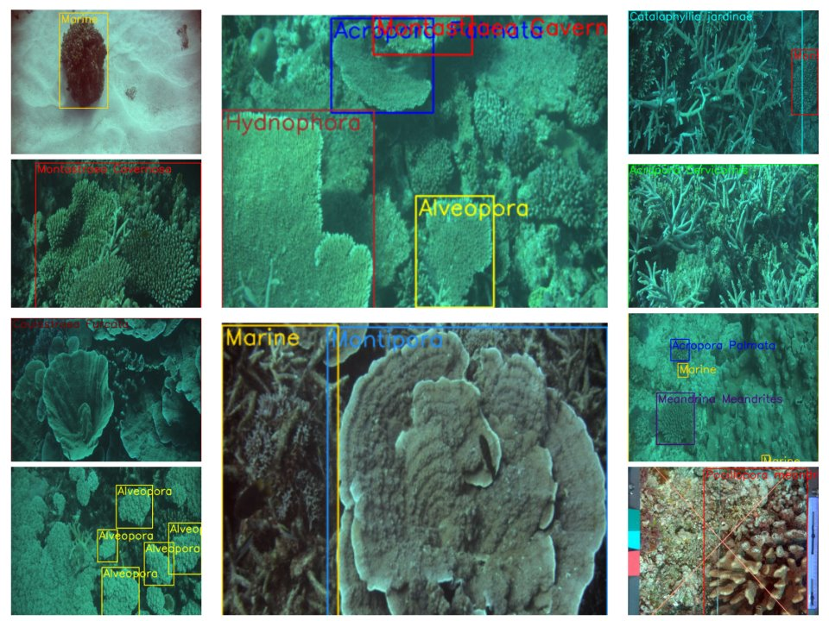
Object Detection Visual Results

Slide 12
Conclusion
Key Takeaways:
Coral monitoring is essential for marine conservation.
AI can automate and enhance coral detection.
EfficientNet-B7 and ViT-G are strong contenders for classification.
YOLOv8x is best for real-time object detection.
Next Steps:
Improve dataset annotation.
Optimize AI models for real-world deployment.
Explore segmentation and multimodal learning.
Acknowledgment: Thanks to marine biologists, AI researchers, and data scientists.
Contact Information:
ayushman.baghel.21033@iitgoa.ac.in
prakhar.gupta.21031@iitgoa.ac.in
Thank You! Questions?

Slide 13
References
https://coral.org/en/coral-reefs-101/why-care-about-reefs/biodiversity/
https://en.wikipedia.org/wiki/Coral_reef
https://oceanservice.noaa.gov/education/tutorial_corals/coral07_importance.html
https://www.unep.org/topics/ocean-seas-and-coasts/blue-ecosystems/coral-reefs
https://www.mdpi.com/2072-4292/12/3/489
https://www.mdpi.com/2072-4292/12/3/489
https://arxiv.org/abs/2403.05930
https://github.com/lucidrains/CoCa-pytorch
https://huggingface.co/google/vit-base-patch16-224
https://paperswithcode.com/method/efficientnet

Slide 14
Thanks

